Slide 1
Architecture of GPUs vs. CPUs
Submitted to: Mondira Chakraborty (Lecturer-NDUB)
Presented by: Shazidul Alam
Batch : CSE-19
Id : 0692220005101009
Subject : Computer Architecture
01

Slide 2
CONTENTS OF THIS TEMPLATE
1. Title Page
2. Contents
3. What are CPUs and GPUs?
4. CPU Structure
5. GPU Structure
6. CPU Vendors
7. Gpu Vendors
8. Key Differences Between CPUs and GPUs
9. CPU Components Breakdown
10. GPU Components Breakdown
11. CPU Instruction Execution
12. GPU Instruction Execution
13. Power Consumption: CPUs vs. GPUs
14. Performance in Different Applications
15. Cache and Memory Management
16. Scalability and Efficiency
17. Use Cases of CPUs
18. Use Cases of GPUs
19. Future Trends in CPU and GPU Development
20. Conclusion
02

Slide 3
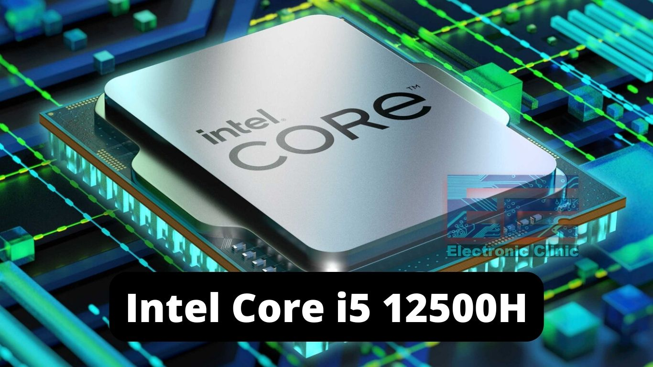
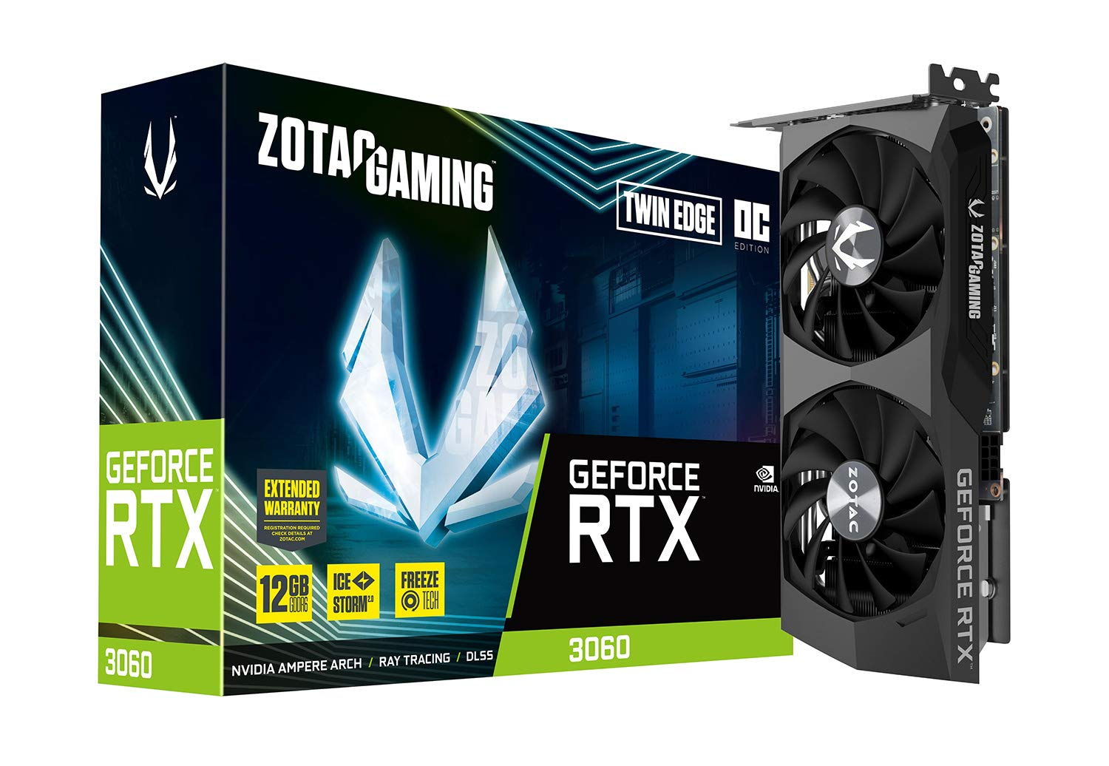
What are CPUs and GPUs?
CPU
GPU
03

Slide 4
Basic Architecture of CPUs
Control Unit
ALU
Cache
04

Slide 5
Basic Architecture of GPUs
Control Unit: Directs all activities.
ALU (Arithmetic Logic Unit): Performs calculations.
Cache: Small memory for quick data access.
05

Slide 6
CPU Vendors
Intel
AMD
06

Slide 7
GPU Vendors
Nvidia
Intel
AMD
07

Slide 8
Key Differences Between CPUs and GPUs
CPU: Focuses on few tasks quickly, strong at decision-making tasks.
GPU: Handles many tasks at the same time, great for parallel processing.
08

Slide 9
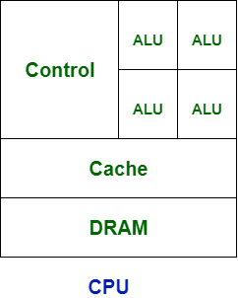
CPU Components Breakdown
09

Slide 10
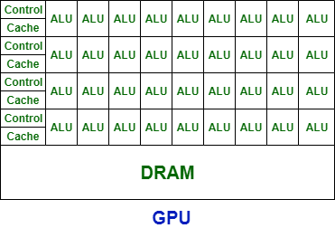
GPU Components Breakdown
10

Slide 11
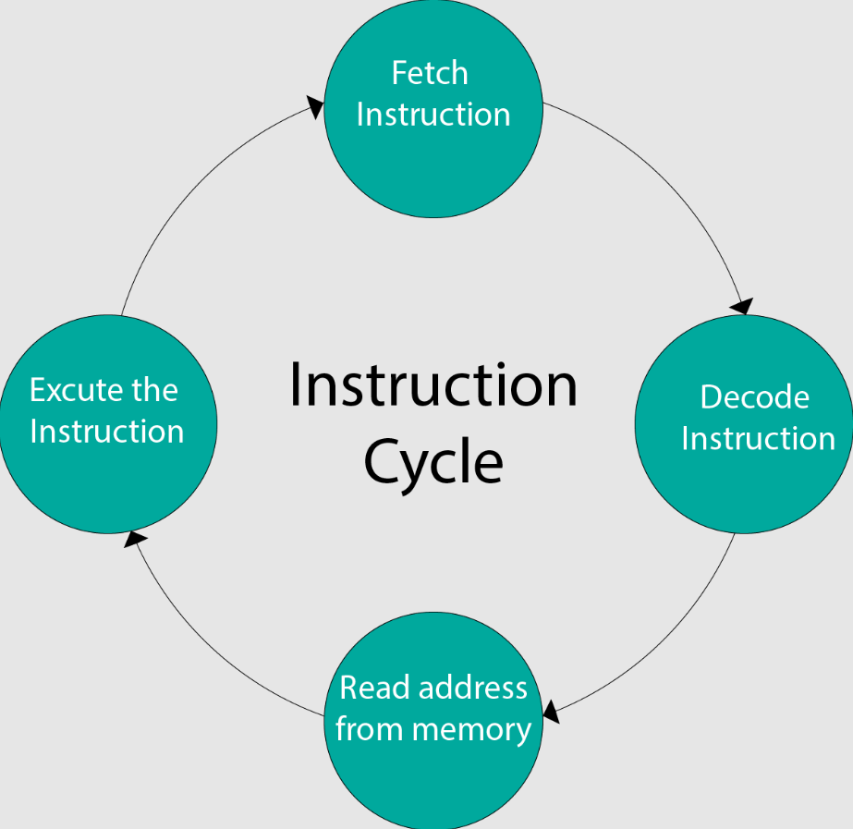
CPU Instruction Execution
11

Slide 12
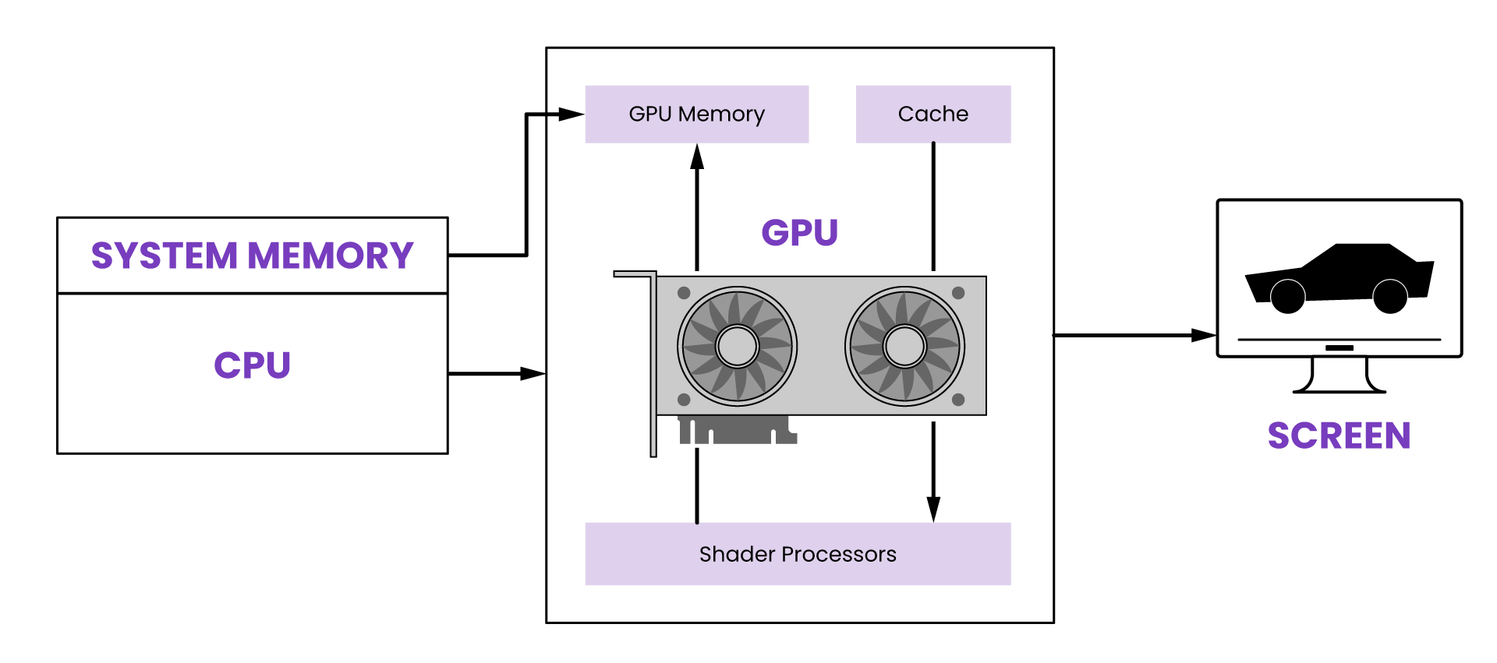
GPU Instruction Execution
12

Slide 13
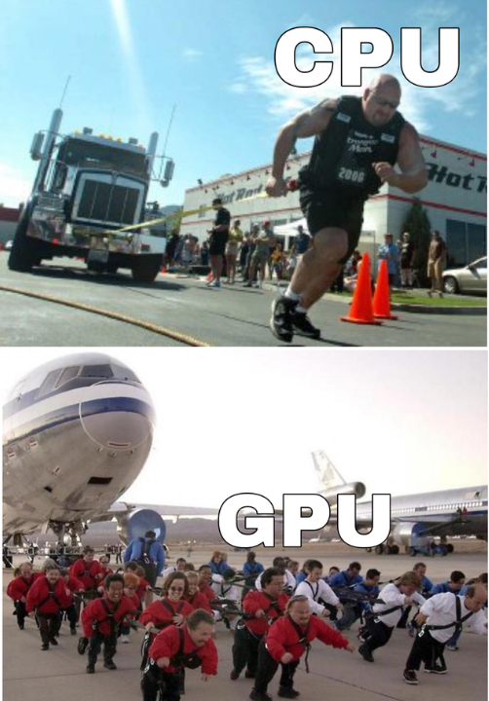
Power Consumption: CPUs vs. GPUs
13

Slide 14
Performance in Different Applications
When CPUs shine: General tasks.
When GPUs shine: Best for graphics tasks.
14

Slide 15
Cache and Memory Management
CPU : Uses a cache system to access data quickly.
GPU : Handles large amounts of data at once, important for graphics and video.
15

Slide 16
CPU and GPU Efficiency
CPU : Adding more cores improves performance, but to a limit.
GPU : Designed for massive performance base tasks with many cores working together.
16

Slide 17
Use Cases of CPU
Running operating systems
Browsing the internet
Basic programs and office tasks
17

Slide 18
Use Cases of GPU
Video games and rendering
Artificial Intelligence and machine learning
Graphic design and animation
18

Slide 19
Future Trends in CPU and GPU Development
CPU Trends: More cores and better power efficiency.
GPU Trends: Improving AI, better for deep learning.
19

Slide 20
Conclusion
In summary, CPUs handle general tasks efficiently, while GPUs excel at parallel processing like graphics and AI. Each plays a vital role in computing, with different strengths suited to specific applications.
20

Slide 21
Thank You
21

